Slide 1
AFFORDABLE YET SAFE HOUSING in SEATTLE, WA
By: Dr Yury Chebiryak

Slide 2
Introduction
Athlete club
Several flats in Seattle, WA
Proximity to a park
Low criminality
Affordable
Extensible analysis to attract other potential clients: property buyers, etc

Slide 3
Data Description
Seattle neighborhoods compared using attributes
Criminality: use official sources
Location: crawl Wikipedia
Pricing: access Airbnb database
Proximity to parks: query Foursquare API
Population size: FindMySeattle portal pages

Slide 4
Methodology
Collect Data
Explore and Understand the Data
Data preparation and preprocessing
Score Engine
Results

Slide 5
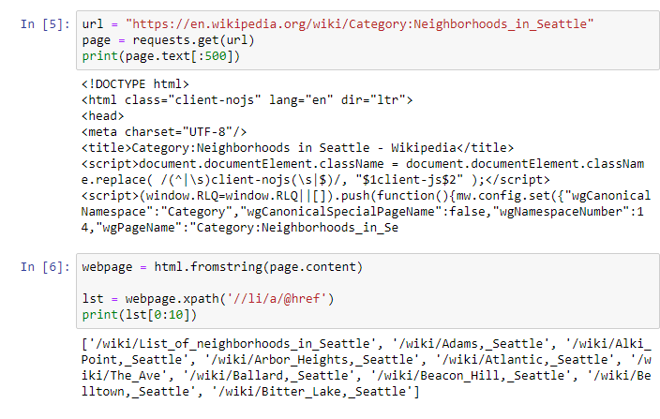
OBTAIN LOCATIONS OF DISTRICTS

Slide 6
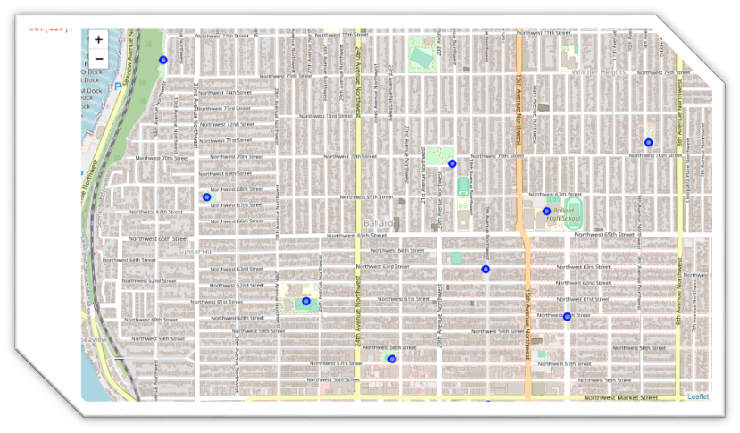
visualize the locations of parks

Slide 7
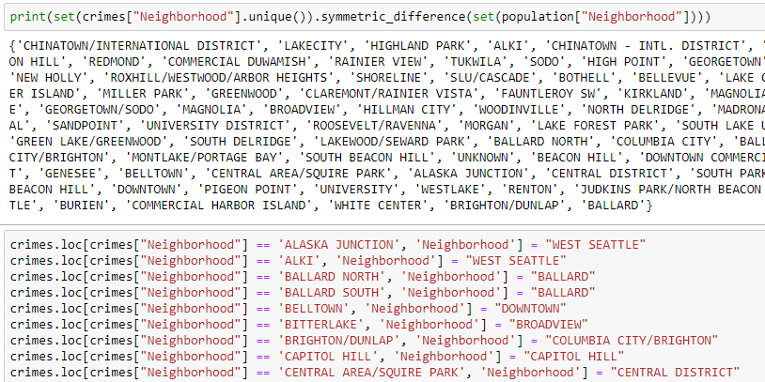
clean and normalize district names

Slide 8
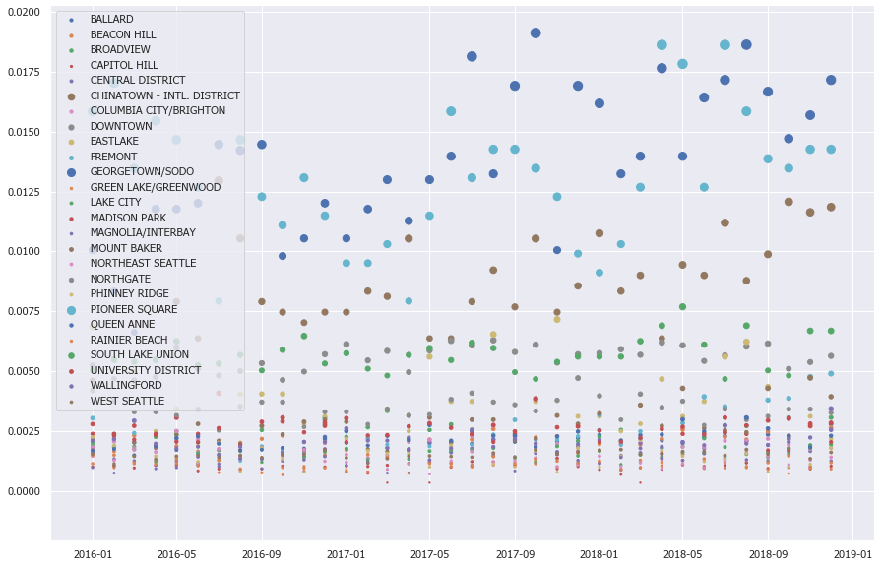
Form monthly breakdown of crimes

Slide 9
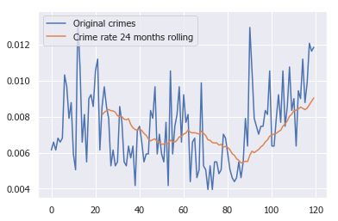
Use two-year rolling per capita as attribute

Slide 10
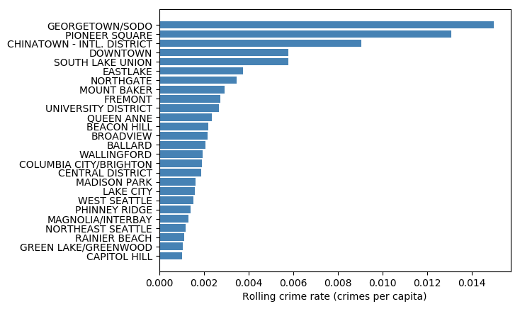
Use two-year rolling per capita as attribute

Slide 11
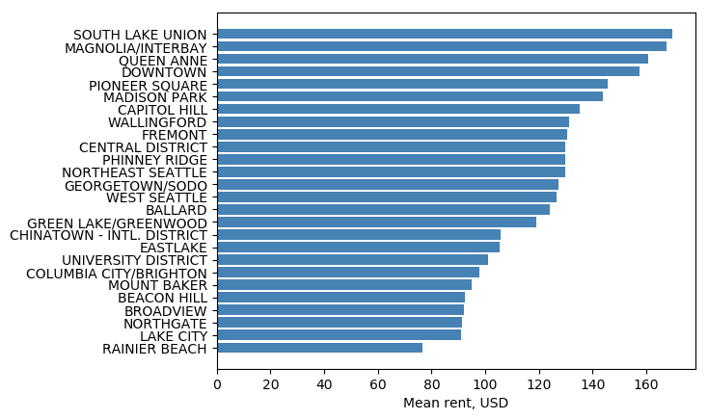
Mean price of flats as attribute

Slide 12
Scoring engine
Desired flat if:
ParkScore + PriceScore * 1.25 + CriminalityScore * 1.5 >= 240, and
ParkScore >= 50
PriceScore >= 50
CriminalityScore >= 60
Where each score is a percentile of their attribute’s distribution

Slide 13
Results

Slide 14
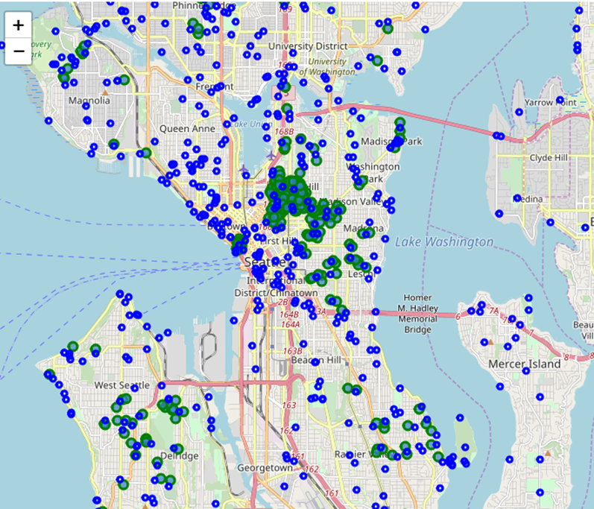
Results: 90% of flats filtered out

Slide 15
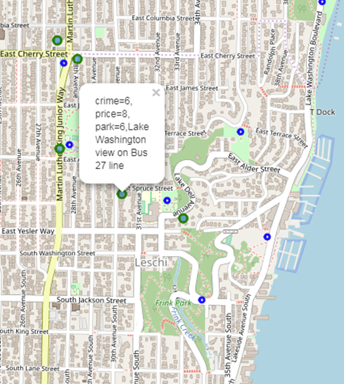
Results: each flat has a label with scores

Slide 16
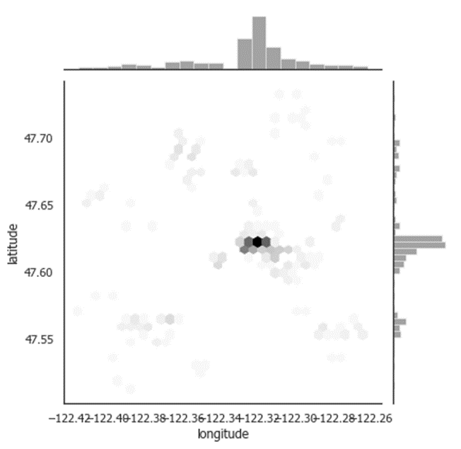
Results: hex grid of desired regions

Slide 17
Conclusion
Hard to find balance between different attributes
We provided interactive tool
meets their desired criteria
easy to understand trade-offs of each offer.

